Slide 1

Team Members:
Abdulrahman el-Bana
Omnia Sameh
Ahmed Yasser

Slide 2
Introduction
04
Pre-Processing
01
Visualizing Dataset
Application
05
02
06
Creating the environemnt
03
Advantages & Disadvantages
07
Training the model
08
Visualizing Test

Slide 3
What is Handwriting Detection?
Way to Recognize Handwriting
Optical Character Recognition
Intelligent Word Recognition
It’s a process that converts an image of text into a machine-readable text format.
It’s the recognition of unconstrained handwritten words.
uses artificial intelligence to recognize whole words in a document as opposed to individual characters.
Handwriting Detection is a technique ability of a computer to receive and interpret intelligible handwritten input from source such as paper documents, touch screen, photographs, etc.

Slide 4
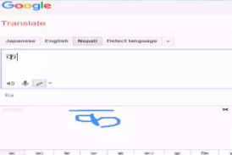
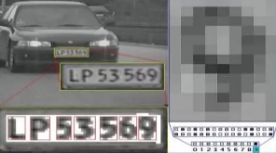

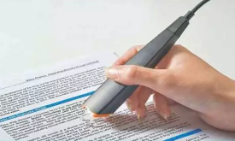
Applications
01
02
Automatic number plate recognition
Make electronic images of printed documents searchable
Machine learning
Yes, Saturn is a gas giant that has several rings
03
04
Assistive technology for blind and visually impaired users
Extracting business card information into a contact list
05
Language translation for road signs

Slide 5
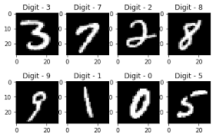
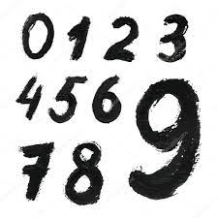
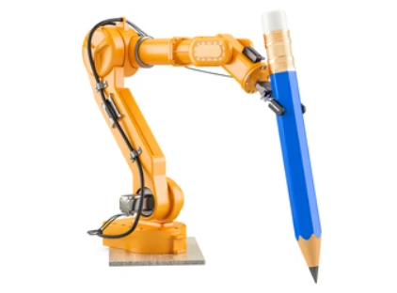
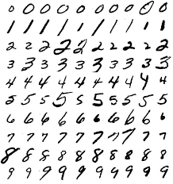
Examples on handwriting images

Slide 6
Advantages
Disadvantages
The most important advantage of speech over handwritin is the speed of data entry. This is because it is much easier to dictate the machine than to write
Noisy to hear someone is sitting next to us and talking to his machine

Slide 7
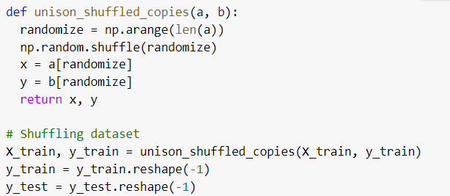
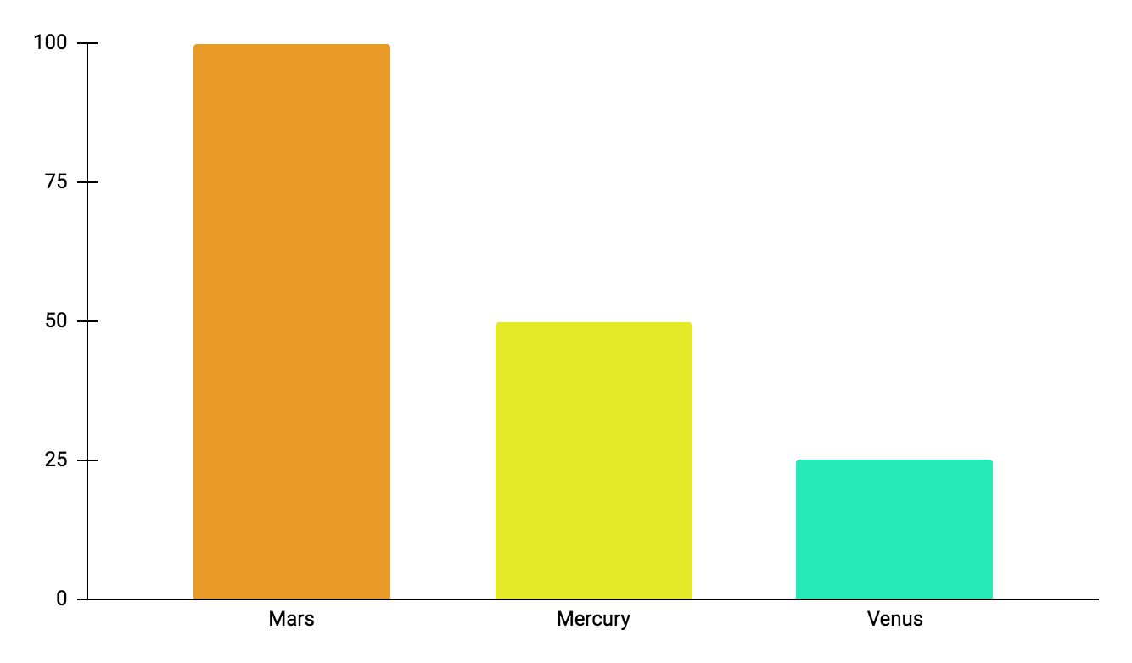
Pre-processing
This is the first step performed in image processing
01
In this step the noise from the image is removed by using median filtering
02
03
Median filtering is one of the most widely used noise reduction technique, this is because in median filtering the edges in image are preserved while the noise is still removed
100%
50%
25%

Slide 8
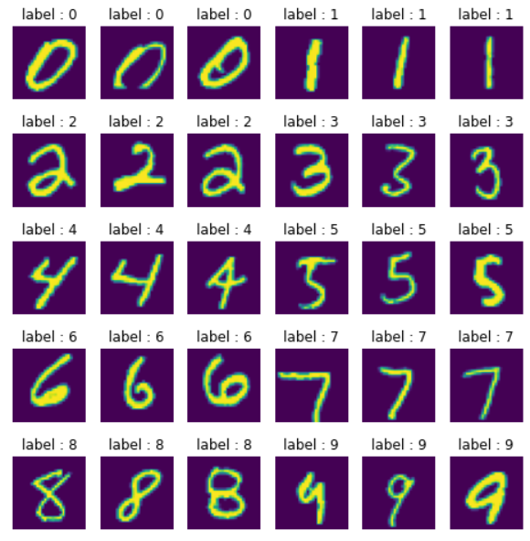
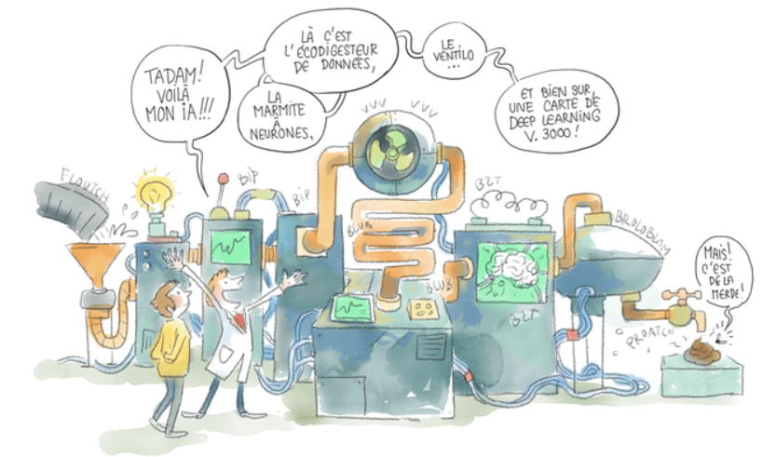
Visualizing Dataset
Machine learning algorithms are complex, and many things can go wrong if you don't know what you're doing.
So a perfect recipe for disaster would be to pick up a dataset and blindly throw deep learning at it.
Before you can use machine learning on a dataset, you need to look at it to clean the data (e.g. to remove outliers), to select the most relevant variables, and to understand its topology to be able to select an adapted machine-learning algorithm.
If you don't do that, it's garbage in, garbage out:

Slide 9
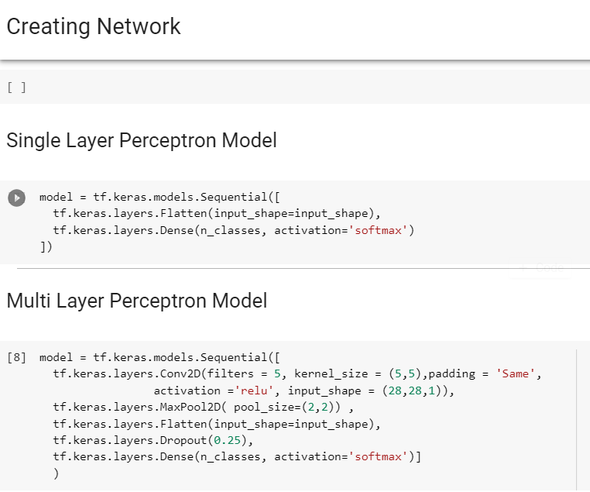
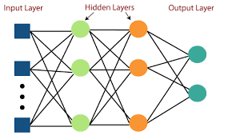
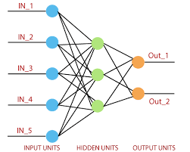
Creating the environment
It’s a fully connected class of feedforward artificial neural network (ANN). The term MLP is used ambiguously, sometimes loosely to mean any feedforward ANN
It’s a feed-forward network based on a threshold transfer function. SLP is the simplest type of artificial neural networks and can only classify linearly separable cases with a binary target (1 , 0).

Slide 10


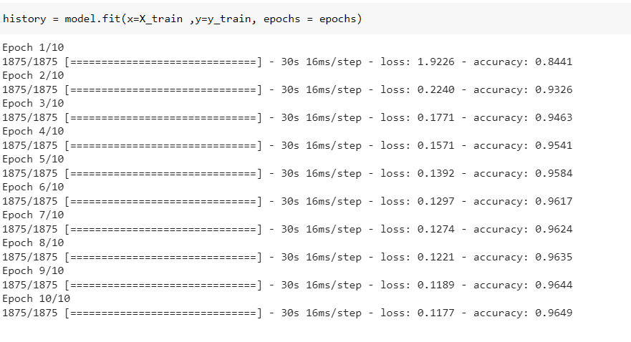
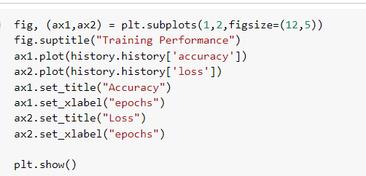
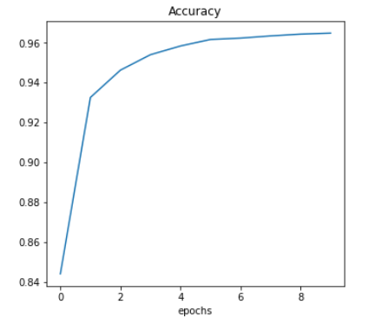
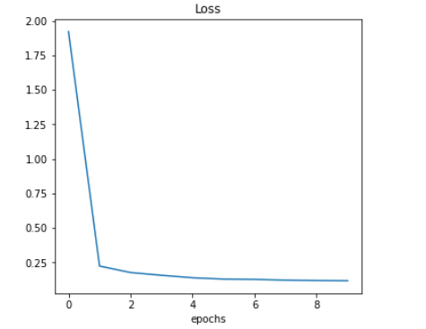

Slide 11
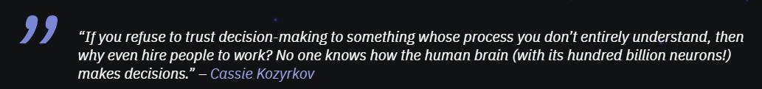
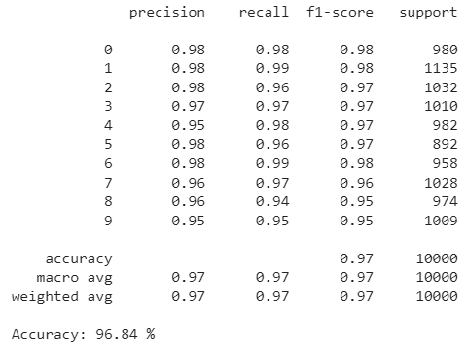

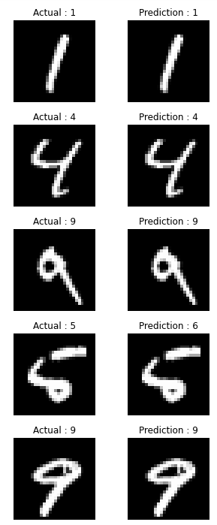
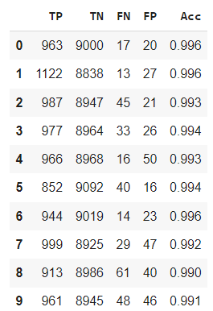

Model Testing & Visualization
01
02
Machine learning models are being trained with terabytes of data with the goal of increasing efficiency while making good decisions at the same time, something that humans do pretty well.
The responsibility that we’re putting on ML models means that we need to be able to make them as transparent as possible because otherwise, we can’t trust them.

Slide 12
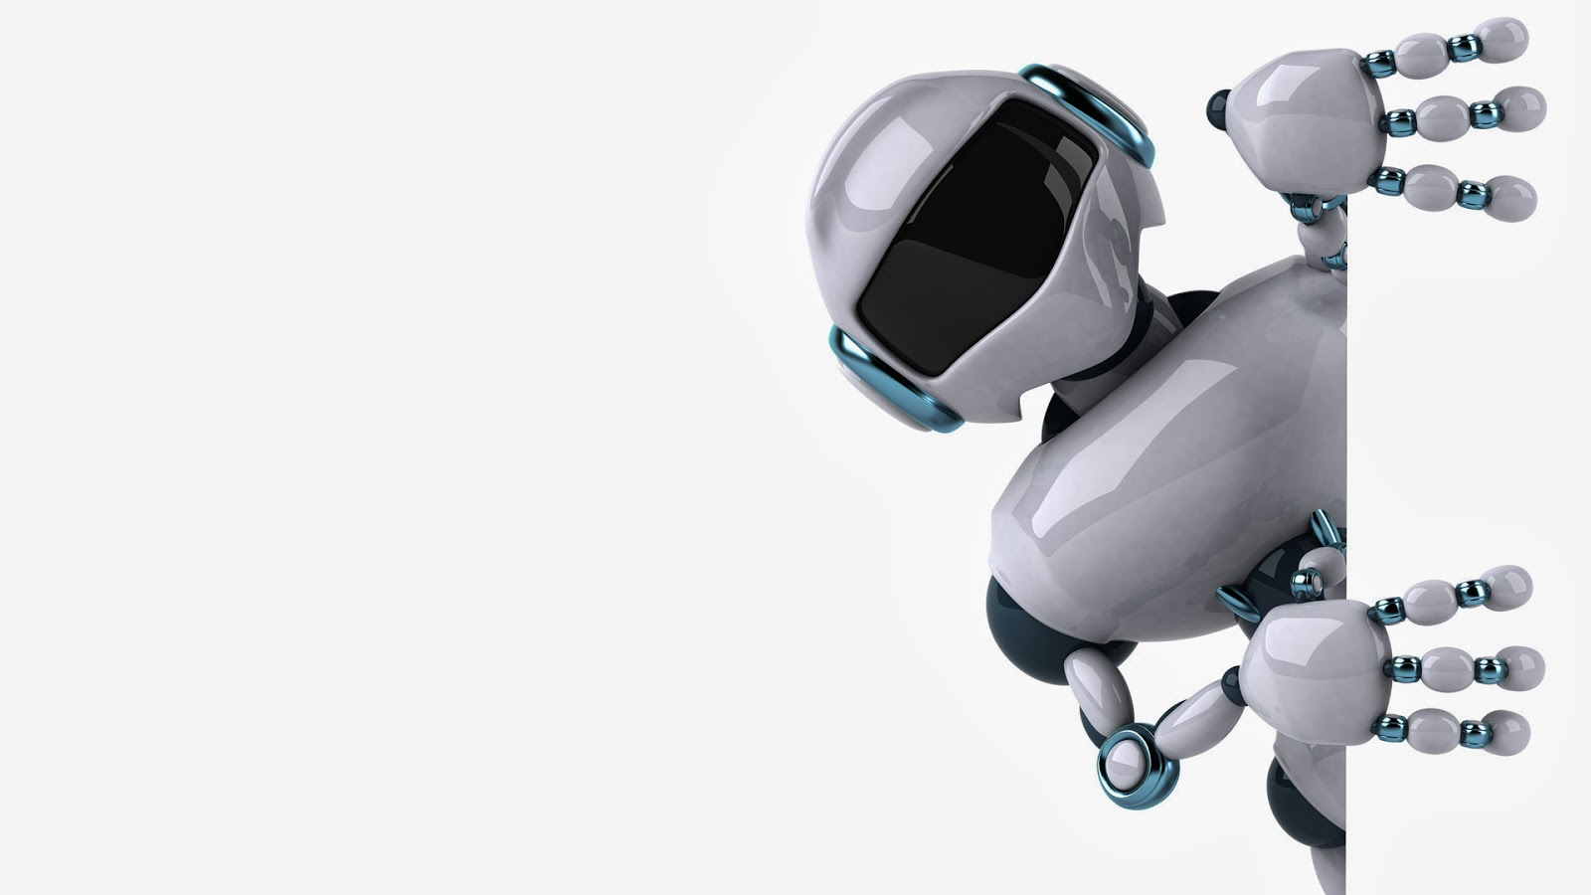
Leader: Abdulrhman el-Bana
Thank You!
Presented to: Eng / Shadi Eng / Rewaa

